Slide 1

Lesson: Functional programming

Slide 2
Lesson: Functional programming

Slide 3
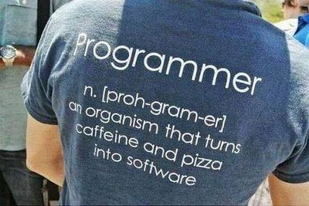
Lesson goals
Functional programming
Optional
Stream API

Slide 4
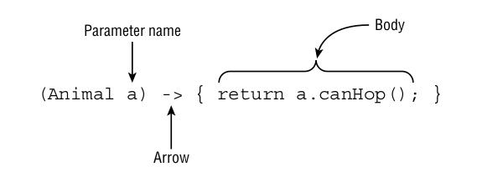
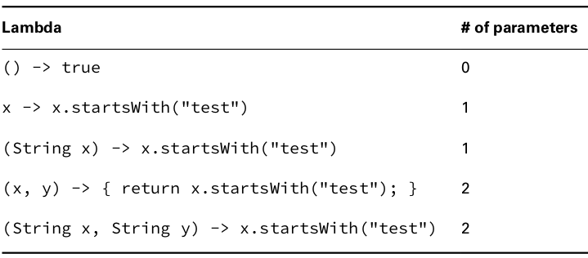
Functional programming
Lambda Expression
Lambdas work with interfaces that have exactly one abstract method.
Java relies on context when figuring out what lambda expressions mean.
■ A single parameter specified with the name a and stating that the type is Animal
■ The arrow operator ( -­> ) to separate the parameter and body
■ A body that has one or more lines of code, including a semicolon and a return statement
The parentheses around the lambda parameters can be omitted only if there is a single parameter and its type is not explicitly stated.

Slide 5
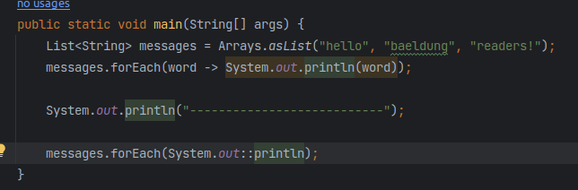
Functional programming
Method References
Method references are another way to make the code easier to read, such as simply mentioning the name of the method.
Method references are a special type of lambda expressions. They're often used to create simple lambda expressions by referencing existing methods.
There are four kinds of method references:
Static methods
Instance methods of particular objects
Instance methods of an arbitrary object of a particular type
Constructor
Notice that method references always utilize the :: operator.

Slide 6
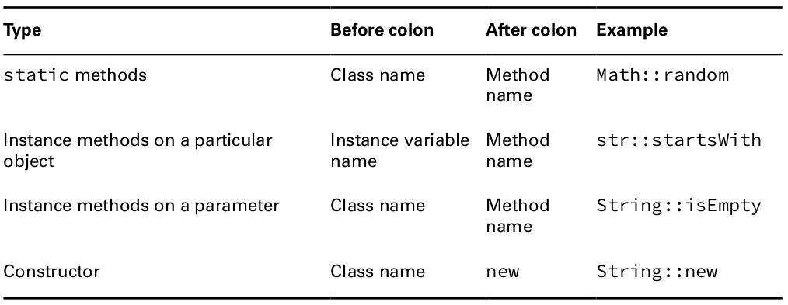
Functional programming
Method References
Reading method references is helpful in understanding the code. Table shows the four types of method references.

Slide 7
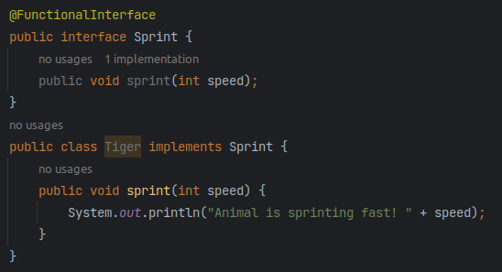
Functional programming
Functional interface
A functional interface is an interface that contains a Single Abstract Method.
Functional interface contains exactly one abstract method
The @FunctionalInterface annotation tells the compiler that you intend for the code to be a functional interface. If the interface does not follow the rules for a functional interface, the compiler will give you an error.

Slide 8
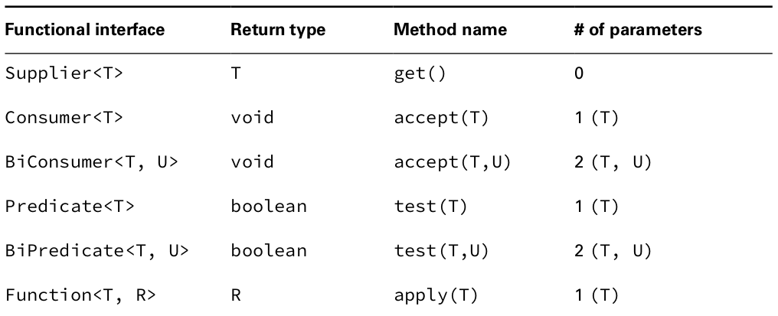
Functional programming
Functional interface

Slide 9
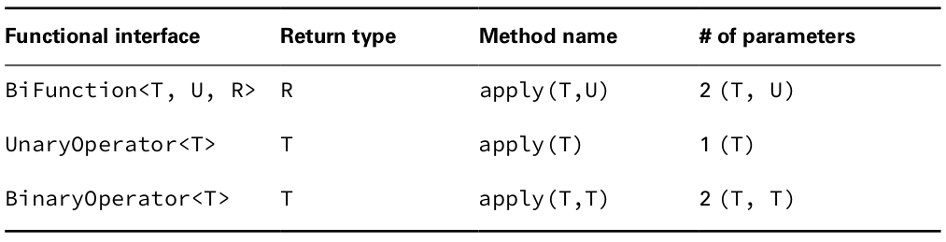
Functional programming
Functional interface

Slide 10
Functional programming
Functional interface Summary
We spent a lot of time in this chapter teaching you how to use lambda expressions, and with good reason. The next two chapters depend heavily on your ability to create and use lambda expressions.
Lambda expressions, or lambdas, allow passing around blocks of code. The full syntax looks like this:
(String a, String b) -­> { return a.equals(b); }
The parameter types can be omitted. When only one parameter is specified without a type, the parentheses can also be omitted. The braces and return statement can be omitted for a single statement, making the short form as follows:
a -­> a.equals(b)
Lambdas can be passed to a method expecting an instance of a functional interface. A lambda can define parameters or variables in the body as long as their names are different from existing local variables. The body of a lambda is allowed to use any instance or class variables.
Additionally, it can use any local variables or method parameters that are final or effectively final.
A method reference is a compact syntax for writing lambdas that refer to methods. There are four types: static methods, instance methods on a particular object, instance methods on a parameter, and constructor references.
A functional interface has a single abstract method. Any functional interface can be implemented with a lambda expression. You must know the built-in functional interfaces.
You should review the tables in the chapter. While there are many tables, some share common patterns, making it easier to remember them. You absolutely must memorize

Slide 11
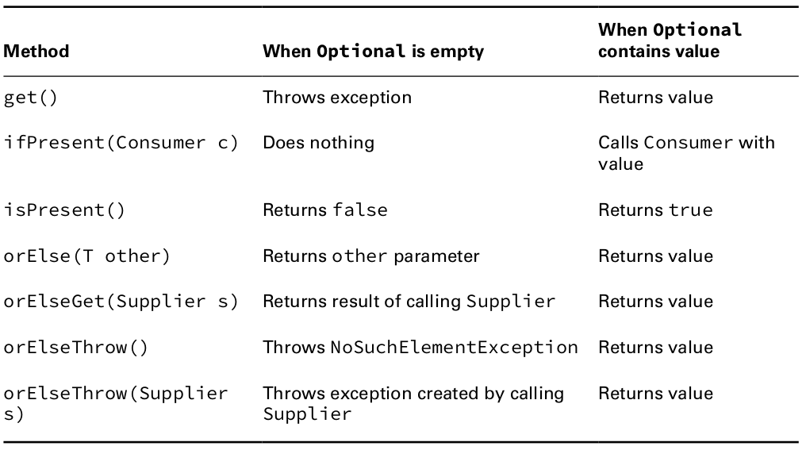
Functional programming
Optional
Optional - the purpose of the class is to provide a type-level solution for representing optional values instead of null references.
To get a deeper understanding of why we should care about the Optional class, take a look at the official Oracle article.

Slide 12
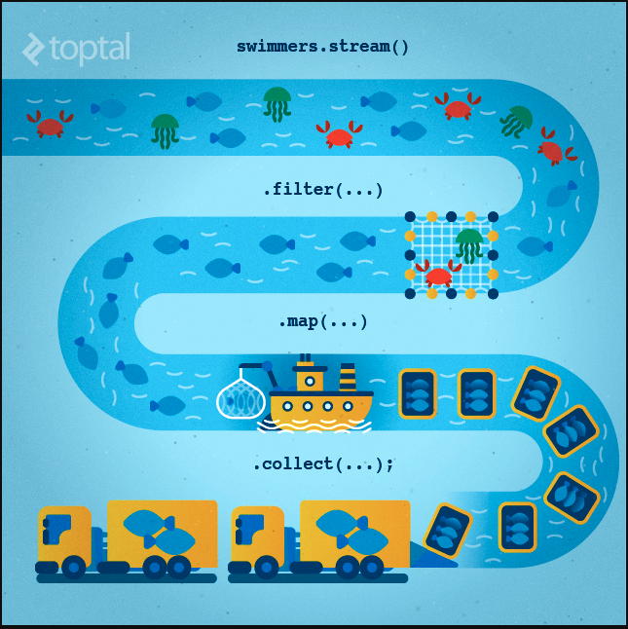
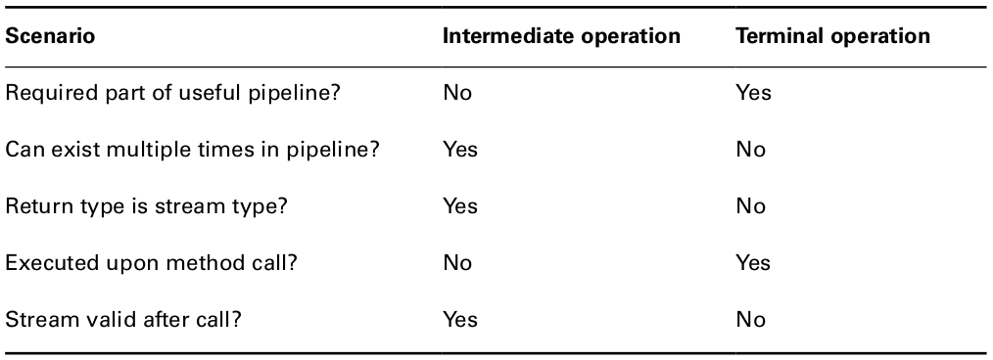
Functional programming
Streams
A stream in Java is a sequence of data. A stream pipeline consists of the operations that run on a stream to produce a result.
Source: Where the stream comes from.
Intermediate operations: Transforms the stream into another one. There can be as few or as many intermediate operations as you’d like. Since streams use lazy evaluation, the intermediate operations do not run until the terminal operation runs.
Terminal operation: Produces a result. Since streams can be used only once, the stream is no longer valid after a terminal operation completes.

Slide 13



Functional programming
Stream Creation
There are many ways to create a stream instance of different sources. Once created, the instance will not modify its source, therefore allowing the creation of multiple instances from a single source.
Empty Stream: We should use the empty() method in case of the creation of an empty stream:
Stream of Collection: We can also create a stream of any type of Collection (Collection, List, Set):
Stream of Array: An array can also be the source of a stream:

Slide 14


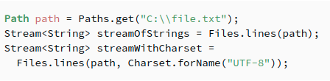
Functional programming
Stream.builder(): When builder is used, the desired type should be additionally specified in the right part of the statement, otherwise the build() method will create an instance of the Stream<Object>
Stream.generate(): The generate() method accepts a Supplier<T> for element generation. As the resulting stream is infinite, the developer should specify the desired size, or the generate() method will work until it reaches the memory limit:
Stream of File: Furthermore, Java NIO class Files allows us to generate a Stream<String> of a text file through the lines() method. Every line of the text becomes an element of the stream:

Slide 15
Functional programming
Referencing a Stream: We can instantiate a stream, and have an accessible reference to it, as long as only intermediate operations are called. Executing a terminal operation makes a stream inaccessible.
Stream<String> stream =
Stream.of("a", "b", "c").filter(element -> element.contains("b"));
Optional<String> anyElement = stream.findAny();
Copy
However, an attempt to reuse the same reference after calling the terminal operation will trigger the IllegalStateException:
Optional<String> firstElement = stream.findFirst();
Copy
As the IllegalStateException is a RuntimeException, a compiler will not signalize about a problem. So it is very important to remember that Java 8 streams can't be reused.

Slide 16
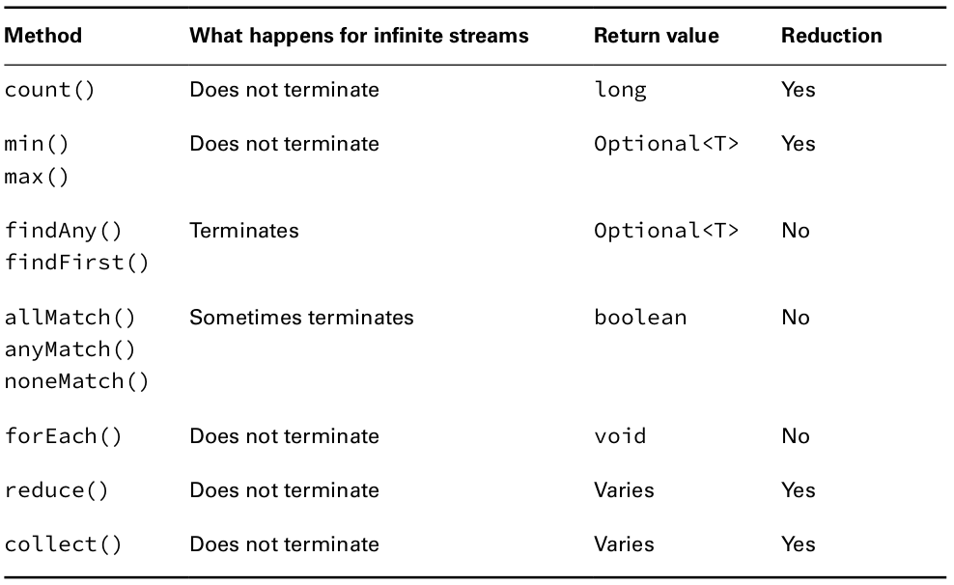
Functional programming
Terminal Operations

Slide 17


Functional programming
Terminal Operations
Counting: The count() method determines the number of elements in a finite stream. For an infinite stream, it never terminates.
Finding the Minimum and Maximum: The min() and max() methods allow you to pass a custom comparator and find the smallest or largest value in a finite stream according to that sort order. Like the count() method, min() and max() hang on an infinite stream because they cannot be sure that a smaller or larger value isn’t coming later in the stream
Finding a Value: The findAny() and findFirst() methods return an element of the stream unless the stream is empty. If the stream is empty, they return an empty Optional . The findAny() and findFirst() methods can terminate with an infinite stream. The findAny() method
is more likely to return a random element when working with parallel streams.
Matching: The allMatch(), anyMatch(), and noneMatch() methods search a stream and return information about how the stream pertains to the predicate. These may or may not terminate for infinite streams. It depends on the data. Like the find methods, they are not reductions because they do not necessarily look at all of the elements.

Slide 18
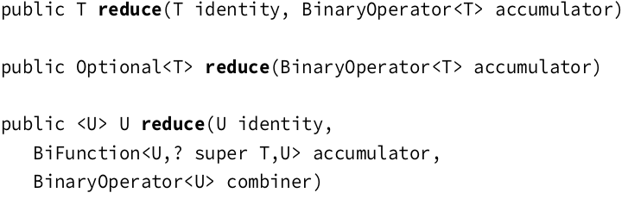
Functional programming
Iterating: As in the Java Collections Framework, it is common to iterate over the elements of a stream. As expected, calling forEach() on an infinite stream does not terminate. Since there is no return value, it is not a reduction.
Reducing: The reduce() method combines a stream into a single object. It is a reduction, which means it processes all elements.
Collecting: The collect() method is a special type of reduction called a mutable reduction.

Slide 19


Functional programming
Intermediate Operations: Unlike a terminal operation, an intermediate operation produces a stream as its result. An intermediate operation can also deal with an infinite stream simply by returning another infinite stream.
Filtering: The filter() method returns a Stream with elements that match a given expression. Here is the method signature:
Removing Duplicates: The distinct() method returns a stream with duplicate values removed. The duplicates do not need to be adjacent to be removed. As you might imagine, Java calls equals() to determine whether the objects are equivalent.
Restricting by Position: The limit() and skip() methods can make a Stream smaller, or limit() could make a finite stream out of an infinite stream.

Slide 20

Functional programming
Mapping: The map() method creates a one-­to-­one mapping from the elements in the stream to the elements of the next step in the stream.
The map() method on streams is for transforming data. Don’t confuse it with the Map interface, which maps keys to values.
Using flatMap: The flatMap() method takes each element in the stream and makes any elements it contains top-­level elements in a single stream. This is helpful when you want to remove empty elements from a stream or combine a stream of lists.
Sorting: The sorted() method returns a stream with the elements sorted.

Slide 21
Functional programming
Taking a Peek: The peek() method is intermediate operation. It is useful for debugging because it allows us to perform a stream operation without changing the stream.
Remember that peek() is intended to perform an operation without changing the result.

Slide 22
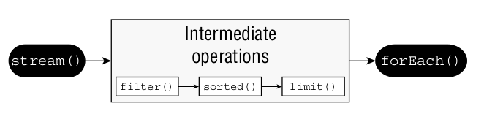
Functional programming
Putting Together the Pipeline:
Streams allow you to use chaining and express what you want to accomplish rather than how to do so.

Slide 23
Thanks!
Find us in Slack:
@Bohdan Cherniak
@Vladyslav Nikolenko
@Volodymyr Vedula

Slide 24
Lesson goals
Functional programming
Optional
Stream API

Slide 25
Functional programming
Lambda Expression
Lambdas work with interfaces that have exactly one abstract method.
Java relies on context when figuring out what lambda expressions mean.
■ A single parameter specified with the name a and stating that the type is Animal
■ The arrow operator ( -­> ) to separate the parameter and body
■ A body that has one or more lines of code, including a semicolon and a return statement
The parentheses around the lambda parameters can be omitted only if there is a single parameter and its type is not explicitly stated.

Slide 26
Functional programming
Method References
Method references are another way to make the code easier to read, such as simply mentioning the name of the method.
Method references are a special type of lambda expressions. They're often used to create simple lambda expressions by referencing existing methods.
There are four kinds of method references:
Static methods
Instance methods of particular objects
Instance methods of an arbitrary object of a particular type
Constructor
Notice that method references always utilize the :: operator.

Slide 27
Functional programming
Method References
Reading method references is helpful in understanding the code. Table shows the four types of method references.

Slide 28
Functional programming
Functional interface
A functional interface is an interface that contains a Single Abstract Method.
Functional interface contains exactly one abstract method
The @FunctionalInterface annotation tells the compiler that you intend for the code to be a functional interface. If the interface does not follow the rules for a functional interface, the compiler will give you an error.

Slide 29
Functional programming
Functional interface

Slide 30
Functional programming
Functional interface

Slide 31
Functional programming
Functional interface Summary
We spent a lot of time in this chapter teaching you how to use lambda expressions, and with good reason. The next two chapters depend heavily on your ability to create and use lambda expressions.
Lambda expressions, or lambdas, allow passing around blocks of code. The full syntax looks like this:
(String a, String b) -­> { return a.equals(b); }
The parameter types can be omitted. When only one parameter is specified without a type, the parentheses can also be omitted. The braces and return statement can be omitted for a single statement, making the short form as follows:
a -­> a.equals(b)
Lambdas can be passed to a method expecting an instance of a functional interface. A lambda can define parameters or variables in the body as long as their names are different from existing local variables. The body of a lambda is allowed to use any instance or class variables.
Additionally, it can use any local variables or method parameters that are final or effectively final.
A method reference is a compact syntax for writing lambdas that refer to methods. There are four types: static methods, instance methods on a particular object, instance methods on a parameter, and constructor references.
A functional interface has a single abstract method. Any functional interface can be implemented with a lambda expression. You must know the built-in functional interfaces.
You should review the tables in the chapter. While there are many tables, some share common patterns, making it easier to remember them. You absolutely must memorize

Slide 32
Functional programming
Optional
Optional - the purpose of the class is to provide a type-level solution for representing optional values instead of null references.
To get a deeper understanding of why we should care about the Optional class, take a look at the official Oracle article.

Slide 33
Functional programming
Streams
A stream in Java is a sequence of data. A stream pipeline consists of the operations that run on a stream to produce a result.
Source: Where the stream comes from.
Intermediate operations: Transforms the stream into another one. There can be as few or as many intermediate operations as you’d like. Since streams use lazy evaluation, the intermediate operations do not run until the terminal operation runs.
Terminal operation: Produces a result. Since streams can be used only once, the stream is no longer valid after a terminal operation completes.

Slide 34
Functional programming
Stream Creation
There are many ways to create a stream instance of different sources. Once created, the instance will not modify its source, therefore allowing the creation of multiple instances from a single source.
Empty Stream: We should use the empty() method in case of the creation of an empty stream:
Stream of Collection: We can also create a stream of any type of Collection (Collection, List, Set):
Stream of Array: An array can also be the source of a stream:

Slide 35
Functional programming
Stream.builder(): When builder is used, the desired type should be additionally specified in the right part of the statement, otherwise the build() method will create an instance of the Stream<Object>
Stream.generate(): The generate() method accepts a Supplier<T> for element generation. As the resulting stream is infinite, the developer should specify the desired size, or the generate() method will work until it reaches the memory limit:
Stream of File: Furthermore, Java NIO class Files allows us to generate a Stream<String> of a text file through the lines() method. Every line of the text becomes an element of the stream:

Slide 36
Functional programming
Referencing a Stream: We can instantiate a stream, and have an accessible reference to it, as long as only intermediate operations are called. Executing a terminal operation makes a stream inaccessible.
Stream<String> stream =
Stream.of("a", "b", "c").filter(element -> element.contains("b"));
Optional<String> anyElement = stream.findAny();
Copy
However, an attempt to reuse the same reference after calling the terminal operation will trigger the IllegalStateException:
Optional<String> firstElement = stream.findFirst();
Copy
As the IllegalStateException is a RuntimeException, a compiler will not signalize about a problem. So it is very important to remember that Java 8 streams can't be reused.

Slide 37
Functional programming
Terminal Operations

Slide 38
Functional programming
Terminal Operations
Counting: The count() method determines the number of elements in a finite stream. For an infinite stream, it never terminates.
Finding the Minimum and Maximum: The min() and max() methods allow you to pass a custom comparator and find the smallest or largest value in a finite stream according to that sort order. Like the count() method, min() and max() hang on an infinite stream because they cannot be sure that a smaller or larger value isn’t coming later in the stream
Finding a Value: The findAny() and findFirst() methods return an element of the stream unless the stream is empty. If the stream is empty, they return an empty Optional . The findAny() and findFirst() methods can terminate with an infinite stream. The findAny() method
is more likely to return a random element when working with parallel streams.
Matching: The allMatch(), anyMatch(), and noneMatch() methods search a stream and return information about how the stream pertains to the predicate. These may or may not terminate for infinite streams. It depends on the data. Like the find methods, they are not reductions because they do not necessarily look at all of the elements.

Slide 39
Functional programming
Iterating: As in the Java Collections Framework, it is common to iterate over the elements of a stream. As expected, calling forEach() on an infinite stream does not terminate. Since there is no return value, it is not a reduction.
Reducing: The reduce() method combines a stream into a single object. It is a reduction, which means it processes all elements.
Collecting: The collect() method is a special type of reduction called a mutable reduction.

Slide 40
Functional programming
Intermediate Operations: Unlike a terminal operation, an intermediate operation produces a stream as its result. An intermediate operation can also deal with an infinite stream simply by returning another infinite stream.
Filtering: The filter() method returns a Stream with elements that match a given expression. Here is the method signature:
Removing Duplicates: The distinct() method returns a stream with duplicate values removed. The duplicates do not need to be adjacent to be removed. As you might imagine, Java calls equals() to determine whether the objects are equivalent.
Restricting by Position: The limit() and skip() methods can make a Stream smaller, or limit() could make a finite stream out of an infinite stream.

Slide 41
Functional programming
Mapping: The map() method creates a one-­to-­one mapping from the elements in the stream to the elements of the next step in the stream.
The map() method on streams is for transforming data. Don’t confuse it with the Map interface, which maps keys to values.
Using flatMap: The flatMap() method takes each element in the stream and makes any elements it contains top-­level elements in a single stream. This is helpful when you want to remove empty elements from a stream or combine a stream of lists.
Sorting: The sorted() method returns a stream with the elements sorted.

Slide 42
Functional programming
Taking a Peek: The peek() method is intermediate operation. It is useful for debugging because it allows us to perform a stream operation without changing the stream.
Remember that peek() is intended to perform an operation without changing the result.

Slide 43
Functional programming
Putting Together the Pipeline:
Streams allow you to use chaining and express what you want to accomplish rather than how to do so.

Slide 44
Thanks!
Find us in Slack:
@Bohdan Cherniak
@Vladyslav Nikolenko
@Volodymyr Vedula

